Slide 1
Students Against Duke Unionization (SADU)
An information session on graduate student unions
Notes:
Dove clipart http://www.clipartkid.com/white-dove-cliparts/

Slide 2
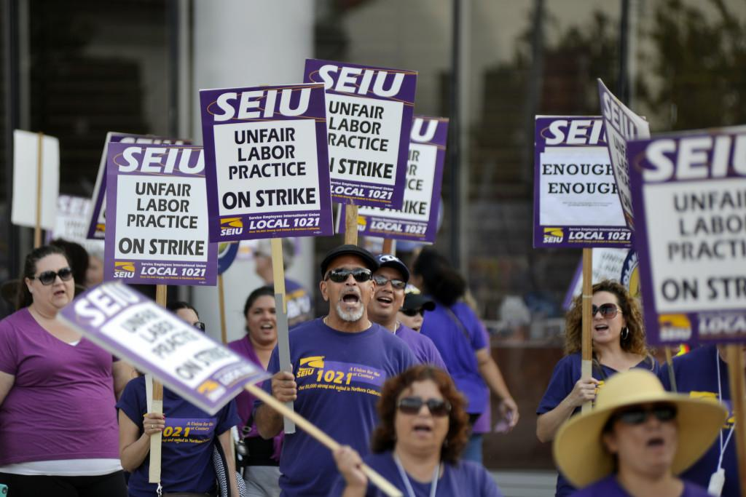
How Did We Get Here?
August 23: NLRB vote → Grad students can form a union
At Duke: Service Employees International Union (SEIU)
Notes:
On August 23 2016, the National Labor Relations Board (NLRB) ruled a 3-1 vote that “student assistants working at private colleges and universities are statutory employees” → Graduate students have a right to form a labor union
Labor union is an organized association of workers, often in a trade or profession, formed to protect and further their rights and interests.
Unionization efforts here at Duke are being lead by the Service Employees International Union (SEIU)
SEIU is a labor union representing almost 1.9 million workers in over 100 occupations in the United States and Canada; although some other unions have represented graduate students before, the SEIU has never before represented graduate students
----------------------

Slide 3
Current Situation
Thursday: SEIU filed a petition
Includes all PhD and Masters students
Holding a hearing to validate union cards
Next step: vote!
Result is based on
51% of the votes,
NOT on 51% of students
Notes:
As of last Thursday (November 10th) SEIU filed a petition to form a union
The union unit was defined by SEIU in their petition
The unit will include “All PhD and Masters students in Duke University departments housed at Duke's campuses in Durham and Beaufort, North Carolina, who are working toward degrees offered by the Duke Graduate School...” (National Labor Relations Board (NLRB), Notice of Petition)
Some students have expressed a belief that they will be able to exempt themselves from the union after it is formed; that is not true. The union group has already been decided in the petition.
Duke University currently in discussion with SEIU and NLRB to finalize:
(1) the unit mentioned
(2) election process/date
If nothing changes, the next step will be to vote: YES or NO to form such union. The tentative date was set for November 30, but this may yet be changed.
The election results count as follows: of the people that voted if 51% voted yes, then the graduate student union forms
Once the union forms, the contract negotiation process begins.
First students represented by the union can come together and decide on the items to include in the working contract.
Then the contract is presented to the university and they have a chance to negotiate. This step can take some time.
-------------------------------

Slide 4
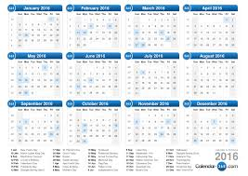
What If We Don’t Like the Union?
If a contract forms, we must wait 3 years to be eligible to file for decertification.
Difficult process: e.g. Minnesota home health care workers
Only 1 in 4 decertification attempts are successful.
x3
Notes:
If a contract is agreed upon between SEIU and Duke, we have to wait 3 years to be eligible to file for decertification
The process of decertification is similar to the process of forming a union (NLRB)
Need to collect authorization cards from at least 30% of the represented group
Then a petition for an election is filed
An election is held to decide if the union is decertified or not.
A group of Minnesota home health care workers have embarked on a campaign to decertify the SEIU. They launched the campaign in July of this year. If they are successful, it would be the largest decertification vote in history. They have not been successful yet.
Data from the NLRB indicates that just one in four decertification attempts are successful. Only half are even put up for a vote.
------------------------------------------------------
http://laborpains.org/2016/07/22/seiu-faces-largest-decertification-vote-in-history/
http://dailycaller.com/2016/07/18/exclusive-minnesota-union-faces-largest-decertification-vote-in-history/

Slide 5
6 Reasons Why We Are Opposed To A Grad Student Union
We Are All Unique. A union risks unfair revisions of department policies that ignore differences between departments.
Loss of Freedom to Negotiate Directly with the administration. Potential additional loss of professional advocacy groups. No Pay = No Say.
Restrictions. Grad-school-wide labor contracts Limit Freedom of Departments to organize and fund travel, TA positions, catered events, etc.
Better Use of Money doing something else
Unions Are Historically Ineffective for increasing pay or health care benefits AND could Increase Our Taxes
Duke Already Has Many Benefits In Place That Past Unions Have Fought For!
Notes:
We Are All Unique. All graduate students would be represented as one unit; may lead to unfair revisions of department policies that ignores differences between fields.
Loss of Freedom to Negotiate Directly with the administration. Potential additional loss of professional advocacy groups (GPSC, EGSC, SAGE).
Grad-school-wide labor contracts Limit Freedom of Departments to organize and fund travel, TA positions, catered events, etc. Additional risk of Restrictions on work hours, choosing TA Positions, conference & travel funding, department events, etc.
Better Use of Money doing something else
Unions Are Historically Ineffective for increasing pay or health care benefits AND could Increase Our Taxes
Duke Already Has Many Benefits In Place That Past Unions Have Fought For
------------------------------------------------------------

Slide 6
We are all unique
>70 departments and programs of study at Duke
We do NOT want the same policies across all departments (from Cultural Anthropology to Mechanical Engineering...)
We do NOT want umbrella political involvement that does not represent everyone’s viewpoint.
Notes:
We are all unique, in distinct graduate departments. All graduate students would be represented as one unit; which may lead to unfair revisions of department policies that ignores differences between fields. https://gradschool.duke.edu/academics/programs-degrees
We also do not want collective political involvement: NYU graduate union voted on whether to impose an academic boycott on Israeli institutions - extremely controversial http://www.thejewishweek.com/news/new-york/bds-move-nyu-tears-apart-student-union
Note that I’m going to be using NYU as an example throughout several of these slides, because they are the primary example of a private university with a graduate student union. The vast majority of graduate student unions are at public universities, which have protections in place that we lack, due to state laws forbidding union involvement in academic matters. https://unionization.provost.columbia.edu/content/be-informed
As a side note about politics, we are NOT making any political statements one way or the other about Trump or any other U.S. politicians. You may have seen some of our posters with Trump stickers, but those stickers were added to the posters after we put them up. We want to let all of you know that we are not here to make statements on the U.S. government and our group’s only goal is to inform other grad students about the union.
----------------------------------

Slide 7
(2) Loss of direct negotiations & advocacy groups, and payment needed to have a voice
Unions are legally required to represent member AND nonmember employees
Unions have EXCLUSIVE REPRESENTATION
Thus, we would likely lose our existing professional advocacy groups (GPSC, EGSC, SAGE, Young Trustees, departmental committees)
Furthermore: you only have a SAY if you PAY: no dues = no voice and no vote
Notes:
Unions are legally required to represent member AND nonmember employees (National Right To Work Legal Defense Foundation www.nrtw.org)
Exclusive representation" is the special coercive privilege, given by federal law, that empowers union officials to represent all employees in a company’s bargaining unit. This "compulsory union representation" deprives employees, even in Right to Work states, of their right to bargain for themselves. Union officials demand this power, then use it as their excuse to force employees to pay dues for representation they do not want. (National Right To Work Legal Defense Foundation www.nrtw.org)
If a union formed, it would be the exclusive voice to the University for all students it represents on pay, work hours, and other employment matters. Current avenues of communication, like students sitting on department committees, would be removed. Students could no longer talk directly with administration to solve problems. https://unionization.provost.columbia.edu/content/be-informed
Thus, we would likely lose our existing student advocacy groups, including GPSC, EGSC, and SAGE.
Note that students who opt out of paying fees will still be represented by the union but will NOT have a vote in accepting or rejecting union contracts. If not many people pay their dues, which is likely considering the right-to-work policy in North Carolina, then it will be only a small group of dues-paying people who decide the contract for the rest of us. The rest of us will have NO on-campus representation, unless we decide to pay $200 - $600 per year to the union. Furthermore, it will be only this group of dues-paying people who will be able to vote on whether to strike.
Note that this “pay to have a voice” policy is standard operating procedure used by unions in general. Only the paying membership can vote on contracts, and whether or not to strike.
------------------------------
Additional references: SEIU constitution on page 18 (“membership authorization for strike action and membership voting on contract ratification”)
SEIU faq page for adjuncts at Cleveland State: The union represents everyone in the bargaining unit—it is in your own best interest to be involved and active. Union membership (completing the membership form) is a voluntary decision that gives you the right to vote on contracts, elect union officers, serve as an officer, attend meetings and provide your input on issues that affect the union and professional staff, serve on union committees and/or joint-labor management committees, and receive contract negotiation updates. Moreover, as a member of the Union, you will be taking a proactive role in the future of your and your colleagues’ workplace and working conditions. http://www.csuohio.edu/organizations/seiu1199/FAQ.html
http://nuhw.org/seius-bogus-ratification-votes/
http://www.nrtw.org/required-join-pay-private/
----------------------

Slide 8
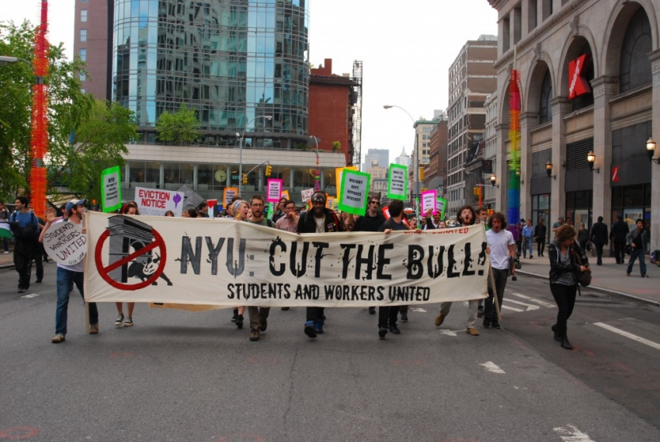
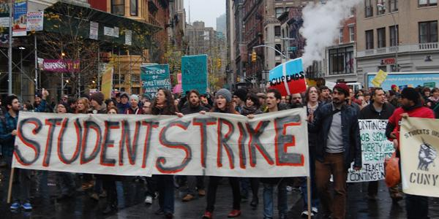
(3) Union restrictions and interference
The union may be able to interfere with work hours, choosing TA positions, conference and travel funding, department events, etc.
Risk of strikes: NYU 2005, 2014
We do NOT have the same automatic protections as public universities!
Notes:
A graduate-school-wide labor contract would limit freedom of departments to organize and fund travel and catered events for their students, and would limit departments on determining policies and parameters around TA positions, etcetera.
At state universities, where most graduate student unions have formed in the past, state law prevents unions from involvement in academic matters, which is good protection against strikes. We would not have those protections at Duke. It would be theoretically possible for a union to call a strike here, and furthermore union members could be fined by the union if found to be not in compliance with the strike action. https://unionization.provost.columbia.edu/content/be-informed
In November 2005, NYU held a months-long strike, and threatened to strike again in 2014 when “the NYU management had not substantively responded to union demands in the past three contract negotiation sessions” http://inthesetimes.com/working/entry/17410/nyu_grad_students_strike
http://www.nytimes.com/2005/11/10/nyregion/graduate-teaching-assistants-go-on-strike-against-nyu.html?_r=0
Union organizers on campus have said that a no-strike/no-lockout clause would be instated in the union contract because a strike would harm us and the university more than it would help anyone...however this is not a guarantee because the contract isn’t written yet. Ultimately at NYU they decided to allow strikes.
---------------------------------------------------------------

Slide 9
(4) Better ways to use the money
Assume 2,000 grad students pay dues (overestimate) x $300/yr (underestimate) = $600,000 to the union instead of to the students
To reiterate: if you do not pay dues, you do not vote on the contract or strikes
Notes:
This is a massive sum of money that we would be giving to the union, that could be better spent elsewhere.
Although NC is a right-to-work state, meaning grad students can opt out of paying fees, even if only ~2000 students pay the fees that is still more than half a million dollars we would be giving them.

Slide 10
(5) Unions are historically ineffective
at increasing pay/benefits
Economic analysis shows that unions:
Sometimes can raise stipends by as much as 8% for TAs, BUT this is countered by a corresponding decrease in tuition benefits: so OVERALL, “unions do NOT increase the total compensation (stipends + tuition remission) for teaching or research assistants.”
We already get paise raises ahead of inflation at Duke.
Contractual unions are NOT effective at bargaining for student health benefits for both TAs and RAs
Note that students at Duke already have significantly above-average health benefits provided
Unions tend to increase intra-university wage variation
For more information, see Schenk, Tom Jr., “The effects of graduate-student unionization” (2007). Retrospective Theses and Dissertations. Paper 14882.

Slide 11
AND a union could increase our taxes!
Reclassification of grad students as employees could result in
LOSS of our current IRS FICA exemption status.
We could be required to pay Social Security (6.2%) and Medicare (1.45%) taxes
Math: 29k stipend, single, 0 dependents, standard deductions
Current take home = $25,429 (Fed 2333, State 1236, FICA 0)
Post-Union take home = $23,211 (Fed 2333, State 1236, FICA 2218)
For us to take home the same amount of pay after a union, our base pay would have to increase 10.6%
Notes:
The reclassification of graduate students as employees can result in a loss of our current IRS FICA exemption status.
We could therefore be required to pay Social Security (6.2%) and Medicare taxes (1.45%)
If we do some quick math for a generic grad student on a 29,000 dollar stipend, single with no dependents and the standard deductions, after a union formed they would have to pay an extra $2,218 per year in FICA taxes as a consequence. For us to take home the same amount after a union, our base pay would have to increase 10.6%!!
Note that this isn’t even taking into account union dues, which would be another burden for the students who decided to be union members.
---------------------------------------------------------------------------------------------
DETAILED OVERVIEW WITH REFERENCES
The reclassification of graduate students as employees will result in a loss of our current IRS FICA exemption status. See their 9167 publication for more information. Therefore, we could be required to pay Social Security (6.2%) and Medicare taxes (1.45%, on a $29k stipend that equates to $2218 in taxes you will now need to pay). While I personally never like to advocate for not paying taxes, it is important to include this change in IRS status, and the implications that come with it, in the evaluation of the potential financial benefits (or pitfalls) that can come from joining a union (see the IRS safe harbor standard (ref 13), section 2(.03), sect. 6(.03) & 6(.04) – 6.03 is the most important section). Note: international students are excluded from FICA but may have changes in visa statuses if they are considered employees instead of students.
Quick math (single, 0 dependents, 29k stipend, std deductions)
Current Take Home: $25,429 (Fed 2333; State 1236 ; FICA 0)
Post Union Take Home: $23,211 (Fed 2333; State 1236; FICA 2218)
Required increase in base pay to equal current take home: 10.6% $32,100
(Note that this is just gross income; this does not account for losses in tuition benefits, the inclusion of union dues, etc. when calculating net income)
To avoid any assertion that this last point is fear mongering, look at this blog post on NYU UAW (ref 14). While the blog authors claim NYU is ‘faulty’ in withholding for FICA, the wording within IRS documents can be interpreted as this outcome being a real possibility. Additionally, UCSC has conditions in which Ph.D. students with 80% or greater appointment are subject to FICA (ref 15) taxation (taken from UCSC student employment policy website (ref 16)). For the technocrats, this is due to the IRS broad wording in 6.03, which states, “…full-time employee [status] is based on the employer’s standards and practices.” Therefore, it is important to emphasize that the costs very well may outweigh the benefits in our case.
References:
1: http://seiufacultyforward.org/graduate-students-are-formin…/
2: https://dukegradunion.org/faq/
3: http://harvardgradunion.org/frequently-asked-questions/
4: http://www.makingabetternyu.org/gsocuaw/for-grad-workers/
5: http://www.uaw4121.org/about/faqs/#q13
6: http://cogs.org/cogs-constitution
7: http://apps.nlrb.gov/link/document.aspx/09031d458202054f
8: http://apps.nlrb.gov/link/document.aspx/09031d458201e5cd
9: http://cogs.org/contract-faqs
10: http://www.seiu509.org/category/higher-education/
11: https://olms.dol-esa.gov/query/getOrgQry.do
12: https://www.unionfacts.com/lu/511865/SEIU/509/#basic-tab
13: https://www.irs.gov/pub/irs-drop/rp-05-11.pdf
14: http://www.makingabetternyu.org/…/faqs-what-to-do-about-ny…/
15: http://careers.ucsc.edu/staff/StudentFICAGuidelines1.pdf
16: http://careers.ucsc.edu/stu…/StudentEmploymentPolicies.html…

Slide 12
Why we oppose this particular union
SEIU HAS NO PREVIOUS EXPERIENCE REPRESENTING GRAD STUDENTS
Suboptimal behavior at Duke: rushing a vote, failing to represent STEM students in the application process, Illegal Behavior (taking down and vandalizing our flyers; bringing faculty to our first meeting; paid union reps starting unwanted conversations with passing grad students), Intimidation tactics
Past history of SEIU
Notes:
SEIU has no previous experience representing grad students. They are involved with the faculty union here, but that union is over 90% humanities faculty so it does not necessarily apply to the diverse graduate student population that SEIU plans to control at Duke.
--------------------------------------------------
Additional sources:
Intimidation tactics at other universities as well http://cornellsun.com/2016/11/13/graduate-students-cgsu-coerces-members-with-emotional-blackmail/
Past history of SEIU: http://www.seiuexposed.com/crime-and-corruption/#.WC3spbVhBHc

Slide 13
SEIU: an unfortunate choice
More than $200M in campaign contributions since 1990 and more than $20M in lobbying since 1998 (source: Center for Responsive Politics)
SEIU has had more than 870 decertification commissions filed against them
Over 6,000 unfair labor practice allegations have been made against SEIU regarding the union’s Duty of Fair Representation
580 allegations of coercive and threatening statements and/or harassment
Past convictions of union leaders: mail fraud, embezzlement, false statements, tax evasion, perjury, theft
Source for numbers: National Labor Relations Board (NLRB)
Notes:
SEIU has been one of the nation’s largest political entities for many years. Their campaign contributions are significantly larger than those from many famous big spenders like oil companies and tech firms. This organization is enormous, and we will be but a drop in the sand to them.
More than $200M in campaign contributions since 1990 and more than $20M in lobbying since 1998 (source: Center for Responsive Politics)
For comparison: SEIU has spent 10x as much as Exxon Mobil, and 3x as much as AT&T in campaign contributions since 1990
SEIU has had more than 870 decertification commissions filed against them
Remember -- these can at the earliest be filed 3 years after the union forms!
More than 6,000 unfair labor practice allegations have been made against SEIU regarding the union’s Duty of Fair Representation
These allegations each mean that a particular union local has felt SEIU has not fairly represented them and their interests in the collective bargaining of contracts
Many of these allegations have been from university employees, including at Brandeis, Harvard Business School, MIT, MIT Lincoln labs, Boston University, and WPI
580 allegations of coercive and threatening statements and/or harassment
Past convictions of union leaders: mail fraud, embezzlement, false statements, tax evasion, perjury, theft
-----------------------------------------------------------------------------------------------------------------------
Convictions of SEIU ex-leaders:
Tyrone Freeman, ex-President of CUHW: mail fraud, embezzlement, false statements to financial institution; Alejandro Stephens, ex-president SEIU Local 660: mail fraud, tax evasion; Janett Humphries, ex-President SEIU Local 99: conspiracy, embezzlement, perjury; Dana Cope, ex-Executive Director SEIU Local 2008: two felony state charges for theft of >$500,000 in union funds; Cedric Earl Hughes, ex-organizing coordinator SEIU Local 721: embezzlement from union staff
~$19M from Exxon Mobil and ~$73M from AT&T in campaign contributions since 1990
Sources
https://www.unionfacts.com/union/Service_Employees#ulp-tab
https://www.unionfacts.com/union/Service_Employees#rd-tab
https://www.unionfacts.com/union/Service_Employees#political-tab
https://www.unionfacts.com/union/Service_Employees#spending-tab
https://www.unionfacts.com/union/Service_Employees#membership-tab
https://www.unionfacts.com/union/Service_Employees
http://www.seiuexposed.com/crime-and-corruption/#.WC3spbVhBHc
https://www.unionfacts.com/union/Service_Employeeshttps://www.unionfacts.com/union/Service_Employees

Slide 14
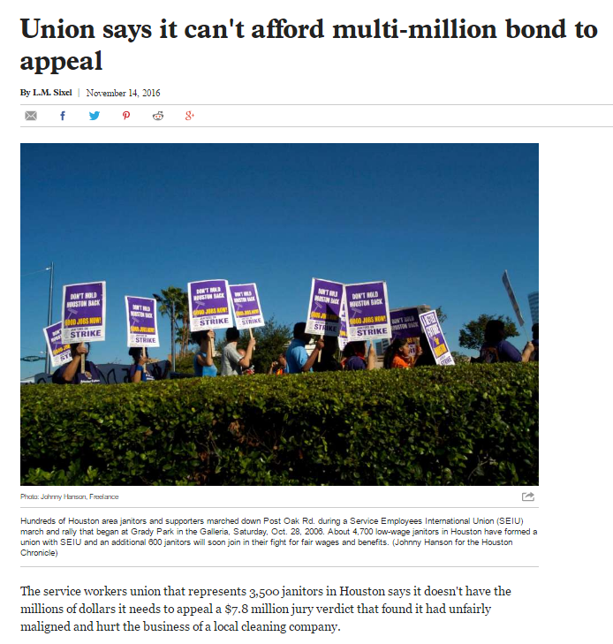
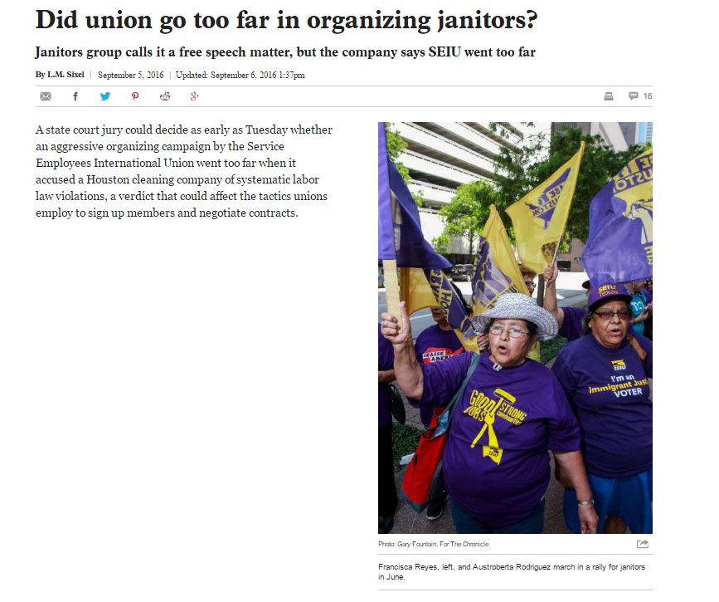
Additional issues related to SEIU
SEIU refuses to give us a charter for our own branch, and has the authority to merge us with any other workers it chooses (Article XIV, Sections 3 & 4 of SEIU constitution)
SEIU has previously been found guilty of misleading individuals about what the union authorization card is before they sign one
SEIU has the authority to tax us to pay for their political operations, hotel rooms, and other “Representation Activities” (Article XV, Section 18): >94% of SEIUs’ income
Notes:
SEIU will NOT give us a charter for our own branch, so we CANNOT elect our own officers, we CANNOT decide how to spend a cent of our own dues money. Having our own distinct charter would allow us to have a say; by denying us a this, SEIU can and will ignore us. Furthermore, SEIU has the constitutional authority to merge us with any other workers it chooses. (See Article XIV, Sections 3 & 4 (pg 25-26) in the SEIU constitution. As the name suggests, the SEIU currently represents a lot of service employees that have working conditions vastly different from graduate students’. For example: The adjunct faculty at Northeastern only make up 7% of their "local," which is primarily composed of healthcare workers. http://s3.amazonaws.com/convdocs.seiume…/…/constitution.pdf…
SEIU has been challenged for misleading individuals about what the union authorization card is before they sign one, for example see http://www.redstate.com/laborunionreport/2012/02/24/seiu-organizing-tactics-include-intimidation-and-lying-to-workers-company-alleges/ (Duke is currently investigating this claim regarding the cards signed this semester)
SEIU has the constitutional authority to tax us to pay for their political operations. See Article XV, Section 18 (pg 31-32) .
This is the source of more than 94% of SEIU’s gross annual income and a majority of SEIU’s annual expenses
37% of gross income spent on “Representation Activities” which are largely supporting unions trying to form (hotels, airfare, supplies like supporters at Duke have)
18% of gross income spent on lobbying and political activities - SEIU gives more money in politics than almost any other entity (including oil companies and tech firms as shown on the previous slide)
https://www.unionfacts.com/union/Service_Employees#spending-tab
------------------------------------
More sources for information on point (1) about not having our own branch:
SEIU's insistence on creating mega-locals has been well-documented and critiqued. The best references are two books:
Moody, Kim. U.S. Labor In Trouble And Transition: The Failure of Reform from Above and the Promise of Revival from Below. New York, NY: Verso, 2007.
Early, Steve. Civil Wars in US Labor: Birth of a New Workers' Movement or Death Throes of the Old? Haymarket. 2011.

Slide 15
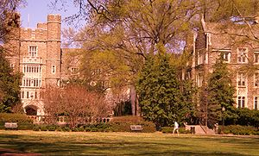
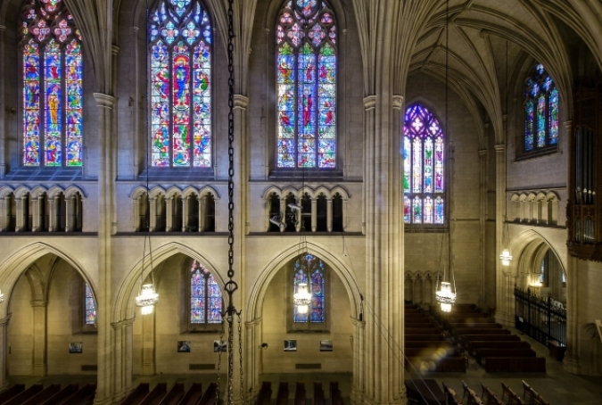
Our final reason: Duke already offers many of the benefits that past student unions had to fight for
Stipend breakdown at Duke: (12.4% raise over past 7 yrs)
Arts & Sciences and Nicholas School departments $29,960
Basic medical sciences and nursing departments $30,310
Engineering departments $29,835
American finance statistics
Poverty line for 1-person household $11,770
Poverty line for 2-person household $15,930
Notes:
Note that Duke has given 2 - 3% raises in the past, and is projecting to give 2% raises in stipends for the next two academic years
https://gradschool.duke.edu/sites/default/files/documents/tuition_fees_stipend_schedule_academic_year_2016-17.pdf
Over the past 7 years alone, graduate students have seen about a 12.4% raise, or on average, a 1.78% raise per year.
https://gradschool.duke.edu/sites/default/files/documents/tuition_fees_stipend_schedule_academic_year_2014-15.pdf
http://www.wendychao.com/science/stipends/2009-10.html

Slide 16
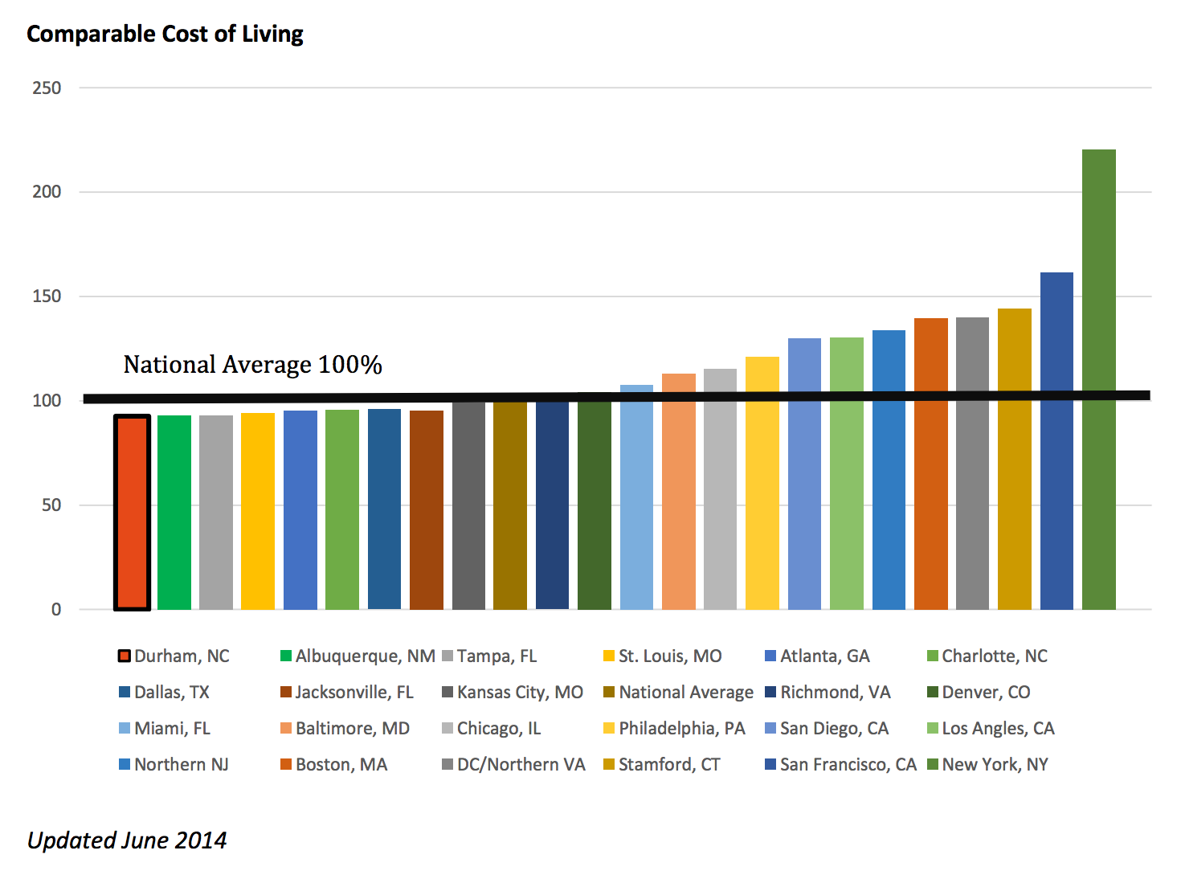
This stipend goes a long way in Durham:
Notes:
This stipend goes a very long way in a place like Durham which has an excellent cost of living.
More cost of living info: Durham’s cost of living ranks overall cheaper than the national average accodring to Sperling’s Best Places, and is especially cheap in housing and utilities http://www.bestplaces.net/cost_of_living/city/north_carolina/durham
Some student unions have “won” higher salaries, but these have been in places with significantly higher costs of living! The same logic does not apply to students at Duke, where we already make a good salary and the cost of living is so much lower.
Chart from http://durhamchamber.org/quality-of-life/cost-of-living

Slide 17
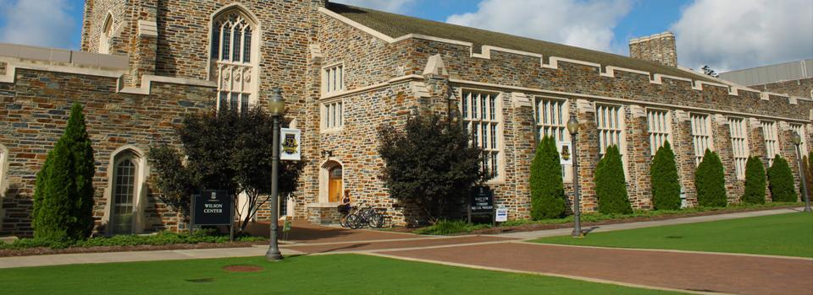
Duke PhD Benefits
Health insurance (plus medical expense assistance program)
Childbirth and adoption accommodations (7 weeks paid time off), childcare subsidy (Duke gives $5,000 for child care; versus only $900 at UW, a unionized school that had to fight for that amount)
Professional development
Short term loans
Ombudsperson (free legal advice - we DO have access to legal counsel already)
Facilities around campus
A Duke University degree!
Notes:
A Duke Degree means a lot, nationally and internationally. How will our application rates change if all incoming graduate students will know that their sole representation will be a union they have to pay dues to in order to have a say?
We currently receive free rec center memberships for a certain number of years, and many departments already pay for students’ memberships in subsequent years
Note that current Duke employees have to pay for their own rec memberships.

Slide 18
Conclusion
We’re opposed to a grad student union because it would:
Ignore our uniqueness as individuals within different departments
Take away our freedom for direct negotiations; potentially remove our advocacy groups; no pay = no say policy.
Restrict work hours, TA parameters, conference & travel funding, department events, etc.
Take away money from graduate students that could be used for something better
and Fail to achieve its promises for better pay or health benefits, and would likely increase our taxes by around $2,000 per year
Furthermore, many of the benefits graduate unions historically brought to students are already available at Duke!
We’re opposed to SEIU based on its current tactics & history of corruption
Duke is already an excellent institution with superior support for its students

Slide 19
How we can prevent the union from forming:
VOTE NO!
Even if you signed an authorization card, you can still vote NO, and you can withdraw your card.
Spread the word. Direct people to our Facebook group or website. Send questions to students.against.union@gmail.com
EVERY vote counts!
Notes:
Facebook group: https://www.facebook.com/groups/studentsagainstdukeunionization/?ref=nf_target&fref=nf
Website:
Email: students.against.union@gmail.com

Slide 20
Legal Note:
We encourage everyone to make use of the sources we have referenced, and to ponder and research this important topic.
SADU is an open, collaborative platform and the statements expressed by its contributors are not subject to professional or peer review. Please be advised that nothing found here has necessarily been reviewed by people with the expertise required to provide you with complete, accurate or reliable information. No representations, express or implied, are made as to the information provided. None of the contributors, administrators or anyone else connected with SADU in any way whatsoever can be responsible for the appearance of any inaccurate or libelous information or for your use of the information contained in or referenced from these pages. You are encouraged to seek the advice of a professional who is licensed and knowledgeable in any matter (legal, financial, risk management, etc.) for which you desire specific advice and/or to verify the veracity of any statements made by or through SADU. The opinions expressed in this presentation are the authors' own and do not reflect the view of Duke University or any other affiliated organization.

