Slide 1
Why vote no?
a presentation by the Independent Thinkers Collective

Slide 2
What’s the Independent Thinker’s Collective?
Duke graduate students
Identify problems and solve them
independent-thinkers.weebly.com
Notes:
We’re a group of Duke grad students who work on a wide range of issues and are currently focusing on the graduate student union.
I personally am also part of Students Against Duke Unionization, which is a separate group. I want to thank them for a couple statistics and phrases I have used here based on another set of slides that we collaborated on last semester.

Slide 3
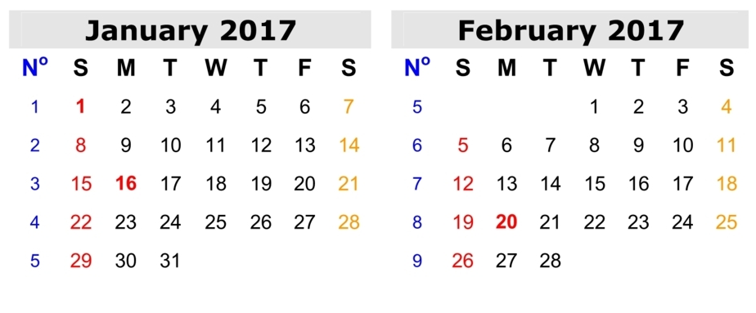
Duke student union status
Ballots mailed February 3rd
Must be received by the NLRB no later than 10:00 AM, February 24th
Notes:
National Labor Relations Board has set the voting window:
Ballots will be mailed out by the NLRB on February 3 (eleven days from today)
and must be mailed back and received by the NLRB no later than 10am on February 24th
That gives you three weeks to cast your vote
Then the ballots will be counted
Images:
http://www.wikidates.org/2017-calendar/2017-calendar-template-05.jpg

Slide 4
Today is the last day to update your address!
Option 1:
Visit the “MyInfo” section of https://work.duke.edu
Requires multi-factor authentication and a SAP user ID and password
Option 2:
Call Duke Human Resources at (919) 684-5600
If your ballot gets sent to the wrong place:
ask someone living there to forward it to you.
EVERYONE should vote!
Notes:
Today is the last day to update your address (midnight on Tuesday January 24th, which I presume is tonight at midnight)
The NLRB will be using the home address on file that is used for the distribution of W-2 forms.
This may be different from your address on DukeHub.
Option 1:
Visit the “MyInfo” section of https://work.duke.edu
Requires multi-factor authentication and a SAP user ID and password
I had a bit of trouble doing this because of some IT malfunctions, so the IT people told me to call Duke Human Resources and that was how I updated my address.
Option 2:
Call Duke Human Resources at (919) 684-5600
Took me about five minutes on hold and two minutes talking to a person and my address was updated.
What if you are unable to change your address?
Ask someone at your old address to forward you your ballot.
It is very important that EVERYONE vote in this election so that the result fairly represents the consensus of the whole student body.
The result is based on 51% of the votes, NOT on 51% of the student body, so if only one person votes then that person is going to decide the whole thing for all of us.
Images:
http://images.clipartpanda.com/ballot-clipart-ballot-box-graphic.jpg

Slide 5
Why vote NO?
(1) Duke already offers an amazing package
(2) A graduate student union will NOT help
(3) A graduate student union will likely HURT
(4) Even if you like the idea of a union, the Service Employees International Union/ SEIU is the wrong union to represent us
Notes:
Image
http://az616578.vo.msecnd.net/files/2016/09/15/636095759448900038-23251662_Vote-NO_1.jpg

Slide 6
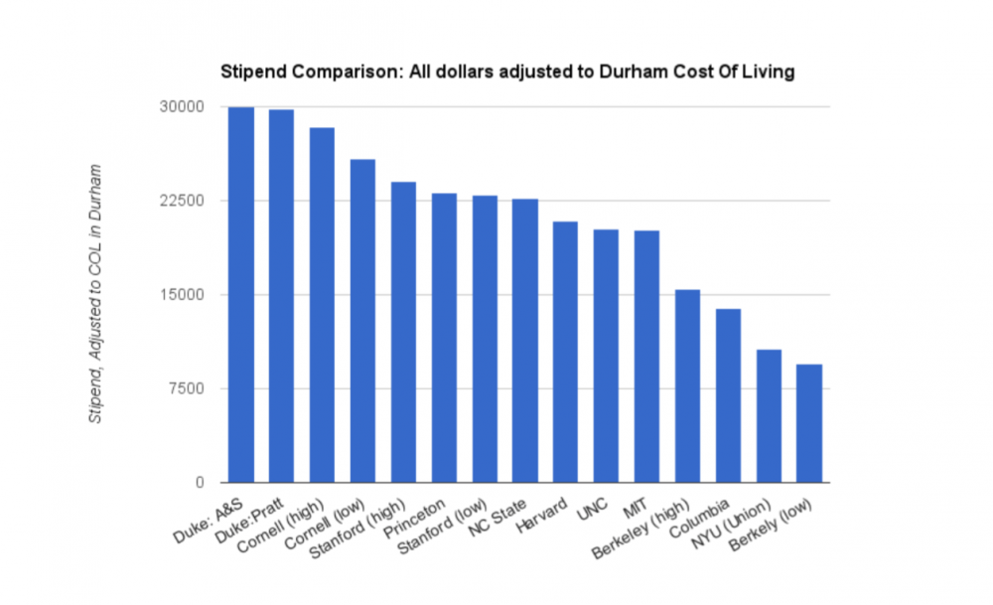
(1) Duke already provides impressive benefits
Notes:
Duke already provides excellent benefits.
This chart compares our stipend with those of peer institutions.
Each year, departments within each school at Duke meet to determine the increase in the stipend
Stipend is set to increase each of the next two years by 2%
Over the past 7 years alone, graduate students have seen about a 12.4% raise.
Some people have expressed fears that Duke will suddenly slash our salaries or our benefits. The fact is, Duke has strong motivation to maintain a competitive package to attract the best candidates and keep current graduate students happy.
Duke’s current package has resulted from many years of good-faith efforts ---------------------------------------------- Note that Duke has given 2 - 3% raises in the past, and is projecting to give 2% raises in stipends for the next two academic years
https://gradschool.duke.edu/sites/default/files/documents/tuition_fees_stipend_schedule_academic_year_2016-17.pdf Over the past 7 years alone, graduate students have seen about a 12.4% raise, or on average, a 1.78% raise per year. https://gradschool.duke.edu/sites/default/files/documents/tuition_fees_stipend_schedule_academic_year_2014-15.pdf
http://www.wendychao.com/science/stipends/2009-10.html

Slide 7
More benefits
Health insurance (plus medical expense assistance program)
Childbirth and adoption accommodations (7 weeks paid time off), childcare subsidy (Duke gives $5,000 for child care; versus only $900 at UW, a unionized school that had to fight for that amount)
Professional development
Short term loans
OneDuke Access Fund
Lawyer-on-call
State-of-the-art facilities around campus
Notes:
Health insurance (plus medical expense assistance program)
Childbirth and adoption accommodations (7 weeks paid time off), childcare subsidy (Duke gives $5,000 for child care; versus only $900 at UW, a unionized school that had to fight for that amount)
OneDuke Access Fund, which can be used to purchase business attire, travel home to one’s country of origin, attend conferences, and cover unanticipated expenses and emergencies
Lawyer-on-call through the Lawyer Assistance Program. Attorneys are available for 3 hours per week to answer questions regarding a wide range of legal issues.
Other benefits
Given that Duke’s benefits already exceed those of most other institutions, the need for a union in the first place is questionable.
------------------------------------------------------------------------------- Learn about the OneDuke Access Fund, GPSC's emergency funding program here - https://gpsc.duke.edu/access-fund/
GPSC and DSG have partnered with a local law firm to continue the Lawyer Assistance Program. Attorneys are now available for three hours per week to answer questions regarding a wide range of legal issues, including street law and police-community interactions. Sign up for a 15-minute time-slot here: http://tinyurl.com/zwjkvq5
Many people have complained about changes to graduate student health insurance. Any changes made are also in the context of Obamacare, since ALL health insurance plans became more expensive as a natural consequence of mandating insurance for previously uninsured people
Regarding the Rec membership:
We currently receive free rec center memberships for a certain number of years, and many departments already pay for students’ memberships in subsequent years
The only reason some departments do not have free rec memberships is because a few years ago Duke needed to figure out how to afford paying for our health insurance, so they took a survey and asked grad students whether they used their gym memberships. The vast majority said no; most grad students were NOT using the membership provided to them. So, the school decided the best way to pay for our health insurance would be to cancel this membership that most people weren’t using anyway
Images
http://www.geldin.com/wp-content/uploads/2012/03/Health-Insurance.jpg
http://www.delawarefamily.net/images/lawyer.jpg

Slide 8
(2) A graduate student union will not help

Slide 9
Grad students have such high turnover it limits efficacy of unionization
Most programs at Duke graduate 2 years faster than the national average
High turnover rate of graduate students makes unionization largely ineffective
Notes:
Images
http://www.insperity.com/wp-content/uploads/2015/12/4-reasons-for-high-employee-turnover-large01.png

Slide 10
Union: NOT effective at increasing compensation
Only 1.5% of U.S. universities have a union at all
Grad student unions can raise stipends, HOWEVER
No difference in stipend between RAs at union and non-union schools
The money to pay these wages has to come from somewhere: higher tuition, higher fees, fewer grad students
Unions do NOT raise total compensation (stipends + tuition remission) or net compensation (stipends + tuition remission – fees)
Unions do NOT increase probability of health benefits
Notes:
First, there is not a lot of literature on the economics of graduate student unions, because there are not that many graduate student unions to begin with – only 38 out of 2,400 U.S. universities had a grad student union (as of 2012).
The best economic analysis we were able to find is a Master’s thesis from 2007 and a follow-up working manuscript by Tom Schenk, so we’ll consider the results in that context.
Study used data from the Chronicle of Higher Education and government data to estimate the economic effects of unionization
Grad student unions are effective at raising stipends, but
there is no discernible difference in the average stipends for research assistants at union and nonunion universities
The money to pay these slightly increased wages has to come from somewhere: higher tuition, higher fees, or fewer grad students
This is consistent with the observation that unions do NOT raise total compensation (stipends+tuition remission) or net compensation (stipends + tuition remission – fees)
Furthermore,
Unions do not increase the probability of receiving health benefits for the student or for their dependents
----------------------------------------------------
The Effects of Graduate-student Unionization on Stipends. Tom Schenck. Iowa State University Office of Community College Research and Policy. May 1, 2012. http://tomschenkjr.net/wordpress/wp-content/uploads/2009/07/egsus-rhe.pdf THIS IS A WORKING PAPER – UNPUBLISHED
38 universities had a union in 2012
Note that there are 2,474 public or private four-year institutions in the united states, (http://www.infoplease.com/ipa/A0908742.html) so only 1.5% of universities were unionized
Grad student unions are effective at raising stipends, but ineffective at lowering fees, providing health-care coverage, and lowering intra-university wage variance
Furthermore, wage increases occur by moving money from other aspects of university operations: this means that increased stipends may come at the expense of fewer graduate students, rerouted department funds, or other sources in the operating budget
The findings do not rule out the possibility that unionized workers pay higher tuition or more fees than their counterparts: THUS the data suggest that universities may be able to recoup the cost of paying higher stipends by generating higher revenues through mandatory fees for graduate students or more tuition
There is little evidence that unions reduce the wage inequality between departments within the same university
For more information, see Schenk, Tom Jr., “The effects of graduate-student unionization” (2007). Retrospective Theses and Dissertations. Paper 14882. http://lib.dr.iastate.edu/cgi/viewcontent.cgi?article=15881&context=rtd

Slide 11
Union: NOT effective at addressing race and gender harassment
Current pro-union movement has claimed that a union will decrease race & gender harassment on campus
A union will NOT decrease harassment-related issues and may make matters worse
E.g. NYU only one line in contract: “prominently posted”
Union must represent both perpetrator and victim
A union can be the perpetrator of harassment
Union contracts can mandate complicated grievance procedures that discourage victims from filing at all
Notes:
Currently, policy changes and grievances are approached at the relevant level.
We do not believe unionization will improve the grievance procedures at Duke.
In multiple union contracts, for example NYU’s, there is only one line about sexual harassment: “The University’s Sexual Harassment Policy will be prominently posted.” That’s it.
I was unable to find any evidence that unionized schools have a lower rate of sexual or racial harassment, and I was unable to find any evidence that they deal with it more effectively.
Of important note, if harassment charges are filed against another student or faculty who are members of the union, the union will be required to represent both the perpetrator and the victim, which is significant conflict of interest in settling harassment cases.
Unions themselves can also be perpetrators of harassment. SEIU has over 146 cases filed against them for harassment, as well as 169 cases filed against them for threatening statements (https://www.unionfacts.com/union/Service_Employees#ulp-tab ), which will be discussed more later
Union contracts typically require that grievances be filed directly with the union; the process is often so difficult some report not filing grievances at all. Additionally, failing to follow their specified timeline can, quote, “render the grievance ineligible for further processing”
Overall, a union is likely to cause more problems with harassment than it solves.
Additional References:
(please also see selected references for question 3)
Duke graduate student stipend increases: https://gradschool.duke.edu/sites/default/files/documents/tuition_fees_stipend_schedule_academic_year_2016-17.pdf
https://gradschool.duke.edu/sites/default/files/documents/tuition_fees_stipend_schedule_academic_year_2014-15.pdf
http://www.wendychao.com/science/stipends/2009-10.html
NYU constitution, page 21: “The University’s sexual harassment policy will be prominently posted.” http://www.2110uaw.org/cbas/NYU_CBA_2015_2020.pdf
Another example of “The University’s sexual harassment policy will be prominently posted” for a different NYU-related union: http://www.makingabetternyu.org/gsocuaw/wp-content/uploads/GSOCNYU_2015contract_searchable.pdf
UAW contract example shows how inflexible the grievance procedure can become, e.g. with statements such as “Failure to comply with the time limits set forth herein shall render the grievance ineligible for further processing” http://www.uaw2865.org/resources/current-uaw-contract/#article12
Images
http://combiboilersleeds.com/image.php?pic=/images/problem/problem-7.jpg

Slide 12
(2) A graduate student union will not help
High turnover of students limits union efficacy
Unions NOT effective at increasing total compensation
Unions NOT effective at addressing harassment

Slide 13
(3) A graduate student union will likely hurt

Slide 14
Union: ignores differences between departments & between students
Union contract would have to apply to all PhD students as one unit, even though departments differ significantly
A union forces unified political involvement of the whole student body on controversial issues
Notes:
Certain departments already have benefits established that their students requested due to their unique needs.
A union contract means scrapping all the current benefits and starting over, rewriting all the policies so they apply to everyone.
The union contracts I have seen personally do not distinguish between different departments.
Even if a contract were to attempt to make distinctions, it would rapidly become cumbersome because of having to address over 70 different departments at Duke.
Furthermore, unions ignore differences between individual students. At NYU the graduate union voted on whether to impose an academic boycott on Israeli institutions - extremely controversial
Sources
https://gradschool.duke.edu/academics/programs-degrees
http://www.thejewishweek.com/news/new-york/bds-move-nyu-tears-apart-student-union

Slide 15
Union: requires payment to have a voice
Presently:
We have numerous advocacy groups and all of them represent us for a current annual cost of $0 per student
With a union:
Loss of current advocacy groups
Union = EXCLUSIVE REPRESENTATION
You only have a SAY if you PAY: $600 per year
No union dues = no voice and no vote
Notes:
Right now we have numerous professional advocacy groups: GPSC, EGSC, SAGE, Young Trustees, departmental committees, etc. These all work together to improve our experience every year, for no additional cost to us.
If we were to form a union, these existing advocacy groups would be removed or limited.
Unions are legally required to represent member AND nonmember employees
They have “Exclusive representation“ which is the special coercive privilege, given by federal law, that empowers union officials to represent all employees in a company’s bargaining unit. This "compulsory union representation" deprives employees, even in Right to Work states, of their right to bargain for themselves.
If a union formed, it would be the only voice to the University for all students on pay, work hours, and other employment matters. Students could no longer talk directly with administration or use their professional groups to solve problems.
Note that students who opt out of paying fees will still be represented by the union but will NOT have a vote in accepting or rejecting union contracts. If not many people pay their dues, which is likely considering the right-to-work policy in North Carolina, then only a small group of dues-paying people will decide the contract for the rest of us. The rest of us will have NO on-campus representation, unless we decide to pay $600 per year to the union. Furthermore, it will be only this group of dues-paying people who will be able to vote on whether to strike.
It is unclear whether students will have to be paying members to vote on the initial contract - the first one that is created - but it is a certainty that students will have to pay dues to vote on all future contracts and for decisions on whether or not to strike. This “pay to have a voice” policy is standard operating procedure used by unions in general.
The “pay to have a voice” policy will exclude students who are financially struggling, and is a form of economic discrimination.
Sources
National Right To Work Legal Defense Foundation www.nrtw.org
https://unionization.provost.columbia.edu/content/be-informed
------------------------------
Additional references: SEIU constitution on page 18 (“membership authorization for strike action and membership voting on contract ratification”)
SEIU faq page for adjuncts at Cleveland State: The union represents everyone in the bargaining unit—it is in your own best interest to be involved and active. Union membership (completing the membership form) is a voluntary decision that gives you the right to vote on contracts, elect union officers, serve as an officer, attend meetings and provide your input on issues that affect the union and professional staff, serve on union committees and/or joint-labor management committees, and receive contract negotiation updates. Moreover, as a member of the Union, you will be taking a proactive role in the future of your and your colleagues’ workplace and working conditions. http://www.csuohio.edu/organizations/seiu1199/FAQ.html
http://nuhw.org/seius-bogus-ratification-votes/
http://www.nrtw.org/required-join-pay-private/
----------------------
Images
http://www.moneyworks.co.nz/wp-content/uploads/stealing-money12.png
http://mindthismagazine.com/wp-content/uploads/2013/09/burning-pile-of-money.png

Slide 16
Unionizing may add FICA taxes
Reclassification of grad students as employees could result in LOSS of our current IRS FICA exemption status
We could be required to pay Social Security (6.2%) and Medicare (1.45%) taxes
Math: 29k stipend, single, 0 dependents, standard deductions
Potential extra $2,000 per year in taxes
Notes:
The reclassification of graduate students as employees can result in a loss of our current IRS FICA exemption status.
Note that the NLRB has NO SAY WHATSOEVER on whether we pay FICA taxes.
This is a decision made by Duke and the IRS. If we unionize and declare we are employees, Duke can agree with us and declare yes, you are employees, and then we would have to pay FICA taxes.
These taxes are for Social Security (6.2%) and Medicare (1.45%)
If we do some quick math for a generic grad student on a 29,000 dollar stipend, single with no dependents and the standard deductions, after a union formed they would have to pay an extra $2,000 per year in FICA taxes as a consequence.
Note that this isn’t even taking into account union dues, which would be another burden for the students who decided to be paying voting members.
---------------------------------------------------------------------------------------------
DETAILED OVERVIEW WITH REFERENCES
The reclassification of graduate students as employees will result in a loss of our current IRS FICA exemption status. See their 9167 publication for more information. Therefore, we could be required to pay Social Security (6.2%) and Medicare taxes (1.45%, on a $29k stipend that equates to $2218 in taxes you will now need to pay). While I personally never like to advocate for not paying taxes, it is important to include this change in IRS status, and the implications that come with it, in the evaluation of the potential financial benefits (or pitfalls) that can come from joining a union (see the IRS safe harbor standard (ref 13), section 2(.03), sect. 6(.03) & 6(.04) – 6.03 is the most important section). Note: international students are excluded from FICA but may have changes in visa statuses if they are considered employees instead of students.
Quick math (single, 0 dependents, 29k stipend, std deductions)
Current Take Home: $25,429 (Fed 2333; State 1236 ; FICA 0)
Post Union Take Home: $23,211 (Fed 2333; State 1236; FICA 2218)
Required increase in total compensation to equal current take home: 10.6% $32,100
AND we’ve already seen that unions are not effective at increasing TOTAL COMPENSATION!!!
(Note that this is just gross income; this does not account for losses in tuition benefits, the inclusion of union dues, etc. when calculating net income)
To avoid any assertion that this last point is fear mongering, look at this blog post on NYU UAW (ref 14). While the blog authors claim NYU is ‘faulty’ in withholding for FICA, the wording within IRS documents can be interpreted as this outcome being a real possibility. Additionally, UCSC has conditions in which Ph.D. students with 80% or greater appointment are subject to FICA (ref 15) taxation (taken from UCSC student employment policy website (ref 16)). For the technocrats, this is due to the IRS broad wording in 6.03, which states, “…full-time employee [status] is based on the employer’s standards and practices.” Therefore, it is important to emphasize that the costs very well may outweigh the benefits in our case.
References:
1: http://seiufacultyforward.org/graduate-students-are-formin…/
2: https://dukegradunion.org/faq/
3: http://harvardgradunion.org/frequently-asked-questions/
4: http://www.makingabetternyu.org/gsocuaw/for-grad-workers/
5: http://www.uaw4121.org/about/faqs/#q13
6: http://cogs.org/cogs-constitution
7: http://apps.nlrb.gov/link/document.aspx/09031d458202054f
8: http://apps.nlrb.gov/link/document.aspx/09031d458201e5cd
9: http://cogs.org/contract-faqs
10: http://www.seiu509.org/category/higher-education/
11: https://olms.dol-esa.gov/query/getOrgQry.do
12: https://www.unionfacts.com/lu/511865/SEIU/509/#basic-tab
13: https://www.irs.gov/pub/irs-drop/rp-05-11.pdf
14: http://www.makingabetternyu.org/…/faqs-what-to-do-about-ny…/
15: http://careers.ucsc.edu/staff/StudentFICAGuidelines1.pdf
16: http://careers.ucsc.edu/stu…/StudentEmploymentPolicies.html…

Slide 17
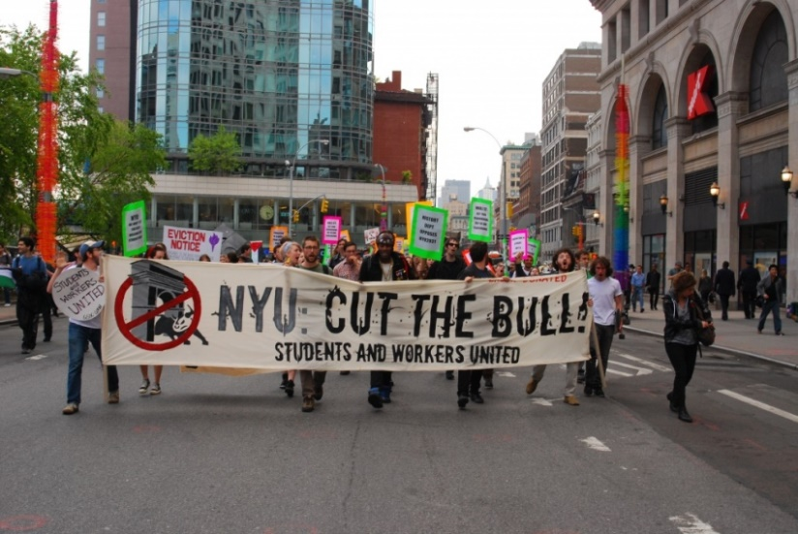
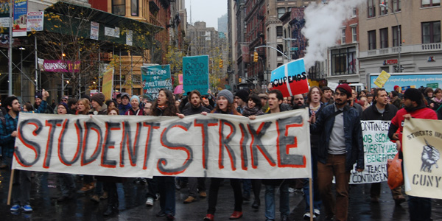
We are unprotected from union interference with academics
Public universities have protections that we lack
A union at a private university CAN interfere with academic matters, e.g. strikes
Notes:
Here at Duke we are unprotected from union interference in academics.
All longstanding graduate student unions (except NYU) are at public universities. This is relevant because public universities fall under state law, and state law prevents unions from involvement in academic matters, which is good protection against strikes.
We would not have those protections at Duke since we are a private institution.
It would therefore be possible for a union to call a strike here, and furthermore union members could be fined by the union if found to be not in compliance with the strike action.
NYU is the only example we have of a long-term grad-student union at a private university.
In November 2005, NYU held a months-long strike, and threatened to strike again in 2014 when “the NYU management had not substantively responded to union demands in the past three contract negotiation sessions”
Union organizers on campus here have said that a no-strike/no-lockout clause would be instated in the union contract...however this is NOT a guarantee because the contract isn’t written yet. Nothing in the contract is a guarantee until it is written, negotiated, and approved.
Besides, if we have a no-strike clause, that takes all the teeth out of any contract. Strikes are the main bargaining chip in a union: if all the auto workers stop going to the auto factory, the company loses a lot of money every day that the factory is shut down. If grad students go on strike, the university keeps operating, and the grad students primarily hurt themselves by delaying their research and delaying their graduation.
It’s a lose-lose situation.
Overall, it’s better not to have a union in the first place.
Sources
https://unionization.provost.columbia.edu/content/be-informed
http://inthesetimes.com/working/entry/17410/nyu_grad_students_strike
http://www.nytimes.com/2005/11/10/nyregion/graduate-teaching-assistants-go-on-strike-against-nyu.html?_r=0

Slide 18
(2) A graduate student union will likely hurt
Ignores differences between departments and between students
Requires payment to have a voice
May add FICA taxes
Real risk of interference with academics, e.g. strikes

Slide 19
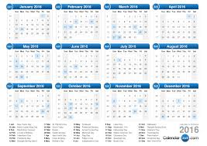
What if we don’t like the union?
If a contract forms, we must wait 3 years to be eligible to file for decertification
Only 1 in 4 decertification attempts are successful and only half are put up for a vote at all
x3
Notes:
If students vote yes and a contract is agreed upon between SEIU and Duke, we have to wait 3 years to be eligible to file for decertification
The process of decertification is similar to the process of forming a union (NLRB)
Need to collect authorization cards from at least 30% of the represented group
Then a petition for an election is filed
An election is held to decide if the union is decertified or not.
Data from the NLRB indicates that just one in four decertification attempts are successful. Only half are even put up for a vote.
------------------------------------------------------
A group of Minnesota home health care workers have embarked on a campaign to decertify the SEIU. They launched the campaign in July of this year. If they are successful, it would be the largest decertification vote in history. They have not been successful yet.
http://laborpains.org/2016/07/22/seiu-faces-largest-decertification-vote-in-history/
http://dailycaller.com/2016/07/18/exclusive-minnesota-union-faces-largest-decertification-vote-in-history/

Slide 20
So, what if you still like the idea of a graduate student union?

Slide 21
So, what if you still like the idea of a graduate student union?
(4) SEIU is the wrong choice for us.
Notes:
SEIU is the wrong choice for us, for numerous reasons.
------------------------------------------------------------------
longtime union activist Beverly Griffith wrote the following to Duke students.
"I never thought I would ever say this but I feel it is my moral duty to do so: Workers are better off with no union than to be with SEIU.
I was a worker and a union member at Alta Bates/Summit Medical Center in California for over 40 years. I believe workers should have a union but I didn’t like that SEIU began to represent the interests of management instead of the interests of workers. I wanted my union to be a strong union so I spoke up. I was constructive in my criticism. That didn’t work so I rallied my co-workers to oppose SEIU’s on-going willingness to bargain away our hard earned benefits. Our members’ calls for change and even for representation went unanswered. Nothing came of our complaints but SEIU continued to collect monthly dues.
I guess I was too much of a thorn in their side. SEIU colluded with my Boss and got me fired—after so many years of dedicated service, I was out of a job. SEIU did nothing. SEIU was happy; my Boss was happy. It was sad that SEIU had been interested in only one thing all along: dues! They do not allow constructive criticism and they are never there when you need them. SEIU is a mistake—a big mistake for workers."

Slide 22
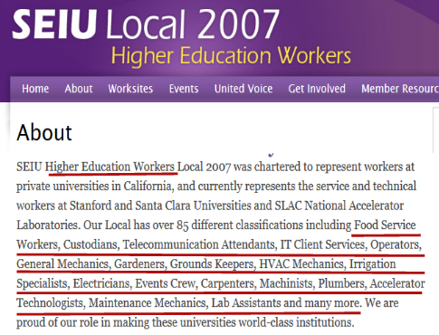
SEIU has never represented graduate students before
SEIU has no previous experience representing graduate students
Their primary industry is health care
Their “higher education workers” are NOT students
Notes:
SEIU has no previous experience representing grad students.
They recently started representing the non-tenure-track faculty at Duke, but that union is over 90% humanities faculty so this is not relevant to the diverse graduate student population SEIU wants to manage at Duke. Furthermore, faculty have different needs from students.
United Automobile Workers (UAW) & American Federation of Teachers (AFT) represent the few existing graduate student unions. When some Duke students were interested in having one of these unions on the ballot as well, SEIU communicated with them and essentially told them to go away or else, which is why SEIU is the only union on the ballot this year.
Even SEIU’s experience with “higher education workers” is not relevant to us – that term includes food service workers, custodians, telecommunications attendants, general mechanics, gardeners, HVAC mechanics, etc. – who are all workers with very different needs from those of graduate students
In the recent court proceedings, SEIU’s lawyers demonstrated numerous times that they are unfamiliar with how graduate school works for many students. For example they stated that a mail-in ballot would be more convenient for students than an on-campus election because “most graduate students are never on campus anyway”.
Images
http://az616578.vo.msecnd.net/files/2016/09/11/636092219744106976-1350992460_hospital%20.jpg

Slide 23
SEIU has a long history of harassment, aggression, and corruption
434 cases filed against SEIU for coercive or threatening statements; 146 for harassment; 57 violence/assaults
80+ pg. intimidation manual unveiled from court proceedings encouraging illegal activity such as extortion and blackmail
Crime:
11 criminal charges
13 embezzlement charges
9 Guilty pleas
Notes:
434 cases filed against SEIU for coercive or threatening statements; 146 for harassment; 57 violence/assaults
A leaked 80+ pg. intimidation manual came out in court proceedings for a different case, recommending illegal activity such as extortion and blackmail
Numerous SEIU leaders have been taken to court for various reasons:, including mail fraud, lying, tax evasion, perjury, and theft.
----------------------------------------------------------------------------------------------------------------
Convictions of SEIU ex-leaders:
Tyrone Freeman, ex-President of CUHW: mail fraud, embezzlement, false statements to financial institution; Alejandro Stephens, ex-president SEIU Local 660: mail fraud, tax evasion; Janett Humphries, ex-President SEIU Local 99: conspiracy, embezzlement, perjury; Dana Cope, ex-Executive Director SEIU Local 2008: two felony state charges for theft of >$500,000 in union funds; Cedric Earl Hughes, ex-organizing coordinator SEIU Local 721: embezzlement from union staff
Sources
https://www.unionfacts.com/union/Service_Employees
https://www.unionfacts.com/union/Service_Employees#crime-tab
https://www.unionfacts.com/union/Service_Employees#ulp-tab
http://www.seiuexposed.com/crime-and-corruption/#.WIUZI_nyuUk
Intimidation tactics at other universities as well http://cornellsun.com/2016/11/13/graduate-students-cgsu-coerces-members-with-emotional-blackmail/ Past history of SEIU: http://www.seiuexposed.com/crime-and-corruption/#.WC3spbVhBHc
SEIU has been challenged for misleading individuals about what the union authorization card is before they sign one, for example see http://www.redstate.com/laborunionreport/2012/02/24/seiu-organizing-tactics-include-intimidation-and-lying-to-workers-company-alleges/
Images
https://dannydpurb.files.wordpress.com/2014/04/fistbw.jpg

Slide 24
Workers are not happy with SEIU’s representation
6,039 cases
filed under Duty of Fair Representation
870 decertification commissions filed against them
Notes:
Over six thousand groups of workers felt that SEIU was not fairly representing them and their interests in the collective bargaining of contracts
Many of these allegations have been from university employees, including at Harvard Business School, MIT, Boston University, and WPI
870 groups have tried to decertify
Remember -- these decertification attempts can at the earliest be filed 3 years after the union forms!
https://www.unionfacts.com/union/Service_Employees#ulp-tab

Slide 25
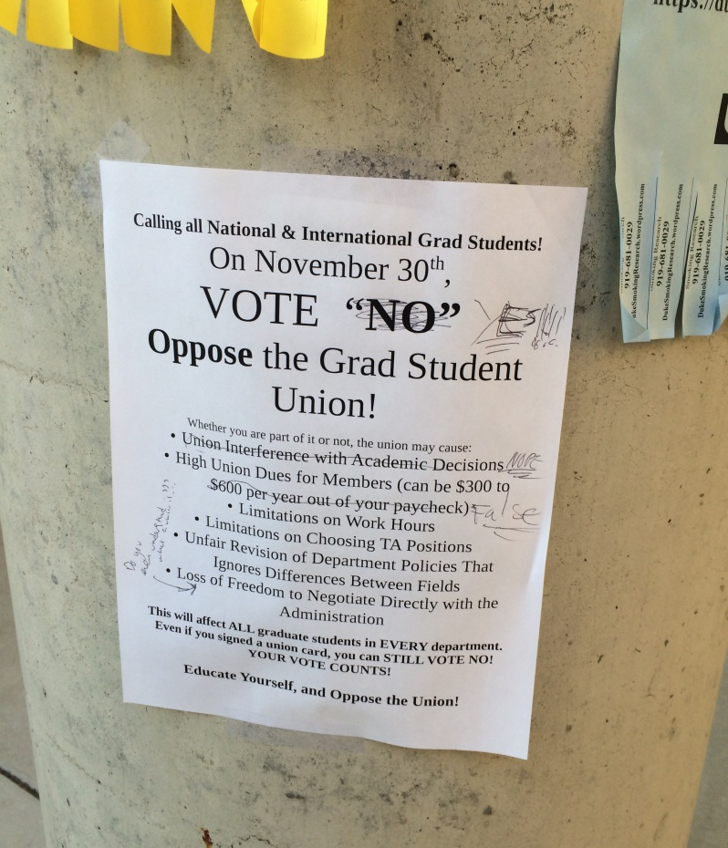
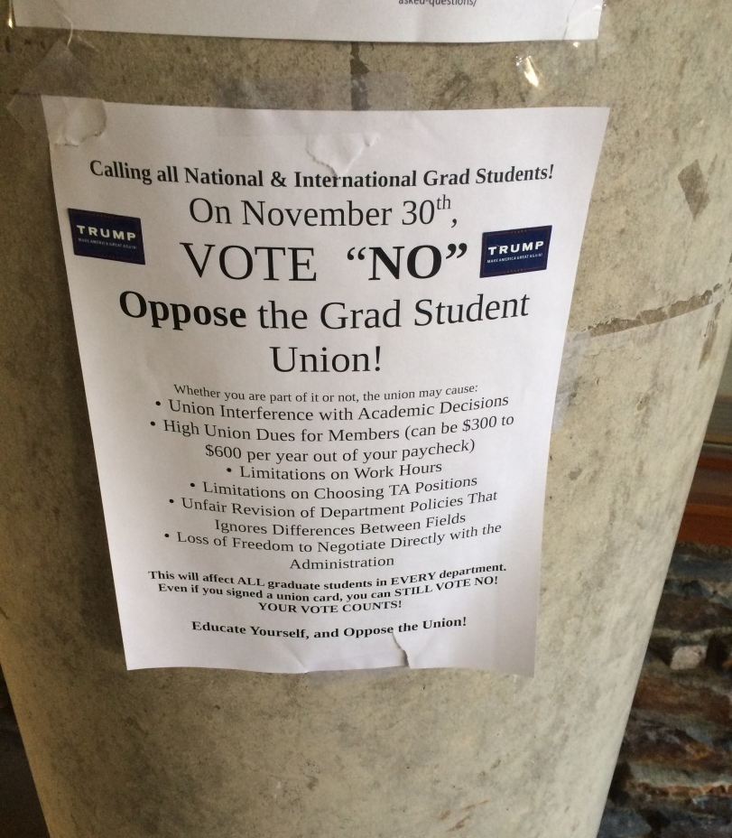
SEIU: suboptimal behavior here at Duke
Notes:
They haven’t exactly behaved very well at Duke either…
Disruption of informational meetings
Removing and defacing flyers – these are only a couple of examples; there is a whole file folder of images like this
Contacting students at their homes and putting signs in their yard without permission
Sending a highly politicized, generic message, instead of addressing specific points about the Duke graduate experience
Bad behavior in court proceedings
12/6/16 SEIU tried to have a “secret record” with NLRB during hearing
Filed 5 affidavits directly to NLRB never notifying Duke.
-------------------------------------------------------------------------------------- Rushing a vote is something that they’ve tried to do in other places as well
http://labornotes.org/blogs/2014/02/viewpoint-seiu-503-rank-and-filers-defeat-mega-local-merger
Similar things happen at other university pro-union efforts (see Yale, Cornell, Harvard)

Slide 26
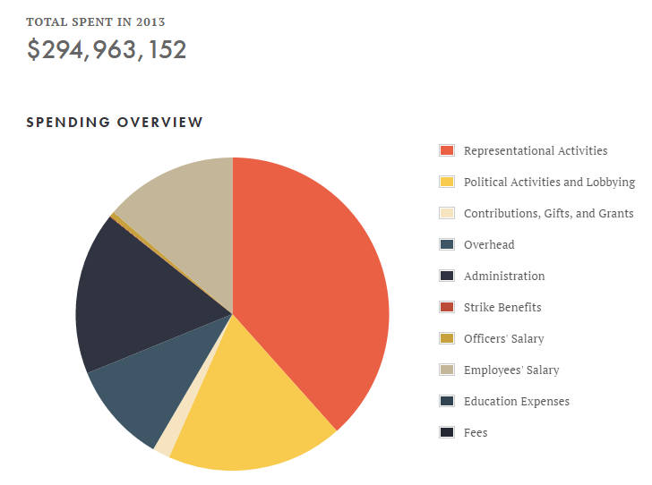
SEIU spends a huge amount on politics and lobbying
10x as much as Exxon Mobil
3x as much as AT&T
Notes:
SEIU spends an incredible amount on politics and lobbying, leaving less money available to benefit workers directly.
18% of gross income spent on lobbying and political activities - SEIU gives more money in politics than almost any other entity
SEIU has spent more than $200M in campaign contributions since 1990 and more than $20M in lobbying since 1998 (source: Center for Responsive Politics)
For scale, this is 10x as much as Exxon Mobil, and 3x as much as AT&T in campaign contributions since 1990
Overhead, administration, and paying their own employees takes 40% of their income (39 specifically)
A remaining 37% is spent on “Representation Activities” , a large category that supports both existing unions and pro-union efforts at various places (Includes expenses like hotels and airfare for union representatives, who you may have seen around campus).
As you can see, they do not even spend close to a majority of their income on workers directly.
-----------------------------------------------------------------------------------------------------------------------
~$19M from Exxon Mobil and ~$73M from AT&T in campaign contributions since 1990
Sources
https://www.unionfacts.com/union/Service_Employees#ulp-tab
https://www.unionfacts.com/union/Service_Employees#rd-tab
https://www.unionfacts.com/union/Service_Employees#political-tab
https://www.unionfacts.com/union/Service_Employees#spending-tab
https://www.unionfacts.com/union/Service_Employees#membership-tab
https://www.unionfacts.com/union/Service_Employees
http://www.seiuexposed.com/crime-and-corruption/#.WC3spbVhBHc
https://www.unionfacts.com/union/Service_Employeeshttps://www.unionfacts.com/union/Service_Employees
---------------------------------------------------------------------------
Representational$108,788,336 (36.88%)
Political Activities and Lobbying$51,632,564 (17.50%)
Contributions, Gifts, and Grants$5,085,567 (1.72%)
General Overhead$29,482,968 (10.00%)
Union Administration$47,748,302 (16.19%)
Strike Benefits$162,816 (0.06%)
To Union Officers$1,526,494 (0.52%)
To Union Employees$38,846,259 (13.17%)
Education$0 (0.00%)
Fees$0 (0.00%)
Source https://www.unionfacts.com/union/Service_Employees#spending-tab

Slide 27
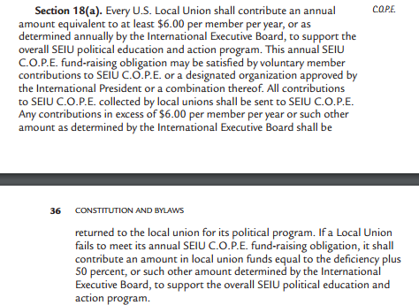
SEIU can also tax us to pay for these political operations
The SEIU constitution gives them this right.
See Article XV, Section 18
Notes:
SEIU has the constitutional authority to tax us to pay for their political operations. See Article XV, Section 18 (pg 31-32)
XV is FIFTEEN

Slide 28
SEIU underrepresents its members by forming mega-locals
Can merge groups without geographical proximity
Groups can be shuffled around and merged at will
See Article XIV, Sections 3 & 4 in SEIU constitution
Notes:
SEIU has a long history of forming mega-locals.
Without a local charter, we would not be able to elect our own officers, or decide how to spend a cent of our own dues money.
SEIU’s constitution gives them the authority to merge us with any other workers it chooses. (See Article FOURTEEN XIV, Sections 3 & 4 in the SEIU constitution.)
SEIU relies heavily on this passage and has taken mega-locals to an extreme, lumping together very large groups. There is no evidence to suggest that Duke is somehow special enough to them to avoid this fate.
As the name suggests, the SEIU currently represents a lot of service employees that have working conditions vastly different from graduate students’. For example: The adjunct faculty at Northeastern only make up 7% of their "local," which is primarily composed of healthcare workers.
---------------------------------------------------------------------------------------------------
SEIU's insistence on creating mega-locals has been well-documented and critiqued. The best references are two books:
Moody, Kim. U.S. Labor In Trouble And Transition: The Failure of Reform from Above and the Promise of Revival from Below. New York, NY: Verso, 2007.
Early, Steve. Civil Wars in US Labor: Birth of a New Workers' Movement or Death Throes of the Old? Haymarket. 2011.
The UHW website claims that a majority of the members of the national SEIU Executive Board are either staff or people who initially came to office through appointment [dan clawson, professor of sociology at the University of Massachusetts Amherst where he was president of the faculty union. ]
http://labornotes.org/blogs/2014/02/viewpoint-seiu-503-rank-and-filers-defeat-mega-local-merger
Example of large local with people from all over the country
http://prospect.org/article/service-workers-fight-share-phillys-revitalized-center-city
“janitors and security guards—in office buildings up and down the Eastern Seaboard, from Florida to Boston”
http://inthesetimes.com/working/entry/5629/seius_mega-local_meltdown_size_matters_but_members_matter_more/
http://labornotes.org/2010/02/california-reformers-beat-appointees-seiu-megalocal%E2%80%99s-first-ever-election
http://mrzine.monthlyreview.org/2008/clawson200508p.html
http://s3.amazonaws.com/convdocs.seiume…/…/constitution.pdf…
http://www.seiu.org/cards/what-you-should-know-about-our-constitution-and-leaders/you-can-read-it-yourself/p3
https://d3jpbvtfqku4tu.cloudfront.net/img/constitution-2016.pdf?mtime=20161110123055

Slide 29
(4) SEIU is the wrong choice for us.
No experience representing graduate students
Long history of harassment, aggression, and corruption
Workers unsatisfied with SEIU
Bad behavior at Duke
Primarily a political organization; can tax us for political operations
Underrepresents members by forming mega-locals

Slide 30
Summary: why vote NO?
(1) Duke already offers an amazing package
(2) A graduate student union will NOT help
(3) A graduate student union will likely HURT
(4) SEIU is the wrong union to represent us
Notes:
Why vote no?
Duke already offers an amazing package. You just need to look up what other universities have and what we have to see clearly how good we have it. Our benefits are already maximized to attract the best students.
A graduate student union will NOT help us.
High turnover of students limits union efficacy
Unions NOT effective at increasing total compensation
Unions NOT effective at addressing harassment
(3) A graduate student union will likely hurt us.
Ignores differences between departments and between students
Requires payment to have a voice
May add FICA taxes
May interfere with academics, e.g. strikes
Even if we later decide we want to get rid of the union, there is a 75% chance we will not be able to get rid of it.
(4) Finally, for those of you who still like the idea of a grad student union, please vote no in this particular election, because SEIU is not the right union to represent us.
Image
http://az616578.vo.msecnd.net/files/2016/09/15/636095759448900038-23251662_Vote-NO_1.jpg

Slide 31
Thank you for coming! Questions?
This presentation and other materials will be available at
www.independent-thinkers.weebly.com
See also the resources from our friends at Students Against Duke Unionization: www.notmyunion.com
Notes:
http://completecolorado.com/pagetwo/wp-content/uploads/2013/10/vote-no-button.gif

